Slide 1
Welcome
11/10/2019
Child Medical Planner
Presented By - Aakanksha Narendra Gaikwad
Class- TE(A)
Roll No. 36002
Guided By- Prof. Sanjay Kalyankar (HOD of CSE)

Slide 2
CONTENT
Introduction
Objectives/Goals
Literature Survey
Brief on System
Innovations Added
Conclusion
References

Slide 3
Introduction
This child medical planner website will help those parents who are busy in their work and do not have sufficient time to remember the dates of vaccination for their child.
This website is created to help those parents to plan the routine checkups and require treatments for their child. The website also has facility to give the brief information about each vaccine and particular checkups.

Slide 4
OBJECTIVES/GOALS
To create a website for those parents who often forget to vaccinate their child on time.
So they can be alert by the SMS or email sent through this website.
Display the information of all vaccinations needed for the child upto 18 years.
Using doctor’s information parents can communicates with the doctors through their email address.

Slide 5
Literature Survey
Author: Samba O. Sow a, A. Duncan Steele b, Jason M. Mwenda c, George E. Armah d, Kathleen M. Neuzil
Date of Publication: 29 August 2017
Domain Vaccine
Introduction: Preventing rotavirus infection through vaccination is a critical
intervention to reduce morbidity and mortality in young children,
Proceeding: In May 2016, 33 African countries have rotavirus vaccine in their EPI, while 21 have yet to
introduce the vaccine.
Title: Reaching every child with rotavirus vaccine
WHO gave a Global Action Plan for
Pneumonia and Diarrhea. Vaccines are just one option to prevent. Thus, a multi-pronged approach is needed.
vaccine effectiveness: After vaccine introduction, confirmed rotavirus cases decreased in infants less than 1 year of
age by 50 and 70 percent respectfully, in 2014 and 2015
Diesease burden : by WHO,the
proportion of diarrheal deaths due to rotavirus is declining, but
there are disparities related to vaccine access.

Slide 6
Literature Survey
Author: Bassey Ebensoa,⁎, Ana Manzanoc, Benjamin Uzochukwub, Enyi Etiabab, Reinhard Hussa,
Tim Ensora, James Newella, Obinna Onwujekweb, Nkoli Ezumahb, Joe Hicksa, Tolib Mirzoeva
Published at: 07 December 2018
Domain: Evaluation and Program Planning
Background: An overall aim of the Logic model is to know how Community Health Worker programme works to improve maternal and child
Health in NIGERIA.
Title: Dealing with context in logic model development
Logic model: Logic models are tools for planning, describing, managing, communicating,
and evaluating a programme
Method:
1.Logic model training
2.Documentary Review
3.Teleconferences
4.Technical workshop
Logic model feature: LM facilitated better understanding of the logic that connected the
CHW programme to its outcomes

Slide 7
Literature Survey
Author: Majid Al Eissa a, b, c, *, Hassan N. Saleheen a, b, Maha Almuneef a, c, Muna Al Saadoon d,
Mona Alkhawari e, Aisha Almidfa f, Fadheela Almahroos g
Published at: 17 July 2019
Domain: International Journal of Pediatrics and
Adolescent Medicine
Title: Child maltreatment prevention readiness in Gulf Cooperation Council
(GCC) countries
Background: Child maltreatment (CM) is a global public health problem
Methods: This cross-sectional study was conducted in the GCC countries. Participants were key
decision makers and senior managers in the field of CM.
Conclusion: GCC countries have to implement large-scale evidence-based CMP programs. Strengthening their material, human, and technical resources, and improving the quality
of scientific data are required to improve each country's
readiness.
Children
exposed to emotional, physical, or sexual abuse are at much greater risk of various negative health
outcomes

Slide 8
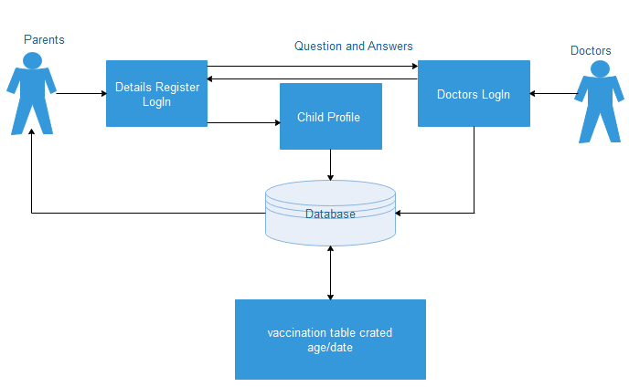
Brief on System
Flow Chart-

Slide 9
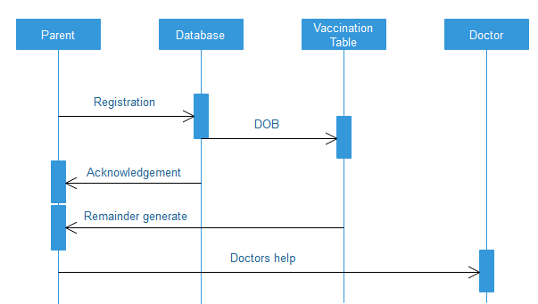
Brief on System
Sequence diagram-

Slide 10
Advantages and Disadvantages
Adavantages
SMS service provided
Easy to understand
Only necessary information provided
World Wide scope
Disadvantages
One user can create only one account.
Every time user has to add the done vaccines.
The remainder will be send through a SMS (offline) but the user first needs the internet to sign up and creating the account.
User has to manage his/her vaccine list date to date.

Slide 11
Conclusion
Informed parents are more likely to appreciate the benefits of vaccines.
With children and adolescents representing the next generation of parents and caretakers, it will be important to develop age-appropriate forms of vaccine communication
Digital vaccination records will be easily accessible to adolescents and young adults, Innovative visual language, based on gender and ethnic equality, is key to patient-driven vaccine communication.

Slide 12
References
http://www.elsevier.com/locate/ijpam
www.elsevier.com/locate/vaccine
www.elsevier.com/locate/evalprogplan

Slide 13
THANK YOU

